Slide 1
ARTICLE OF THE WEEK
Notes:
UNICEF/Karimi

Slide 2
INSTRUCTIONS
Slide 3: Guess the article
Slide 4: Introducing Article 29
Slide 5: Exploring Article 29
Slide 6: Some possible answers
Slide 7, 8 & 9: Primary activities
Slide 10, 11 & 12: Secondary activities
Slide 14: Reflection

Slide 3
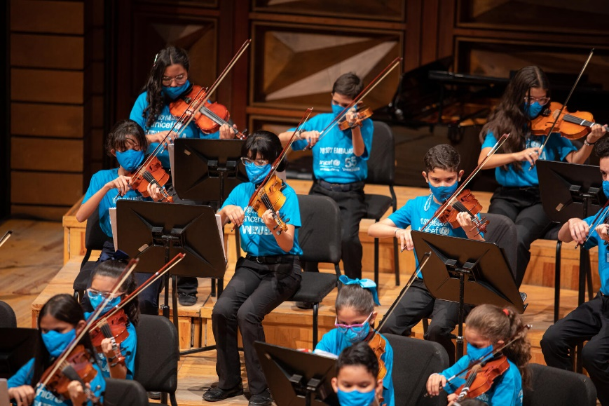
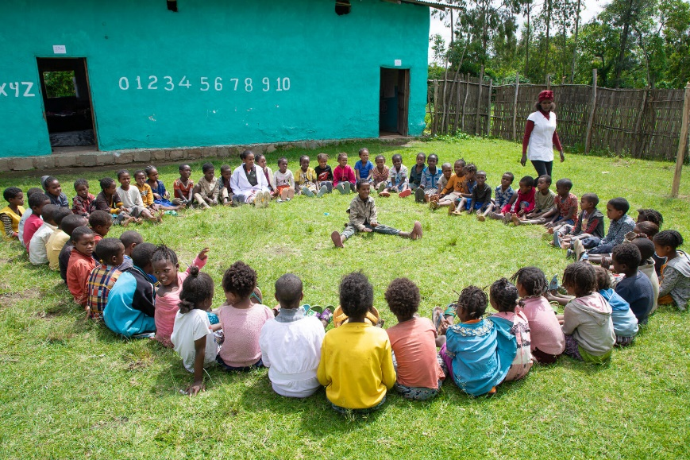
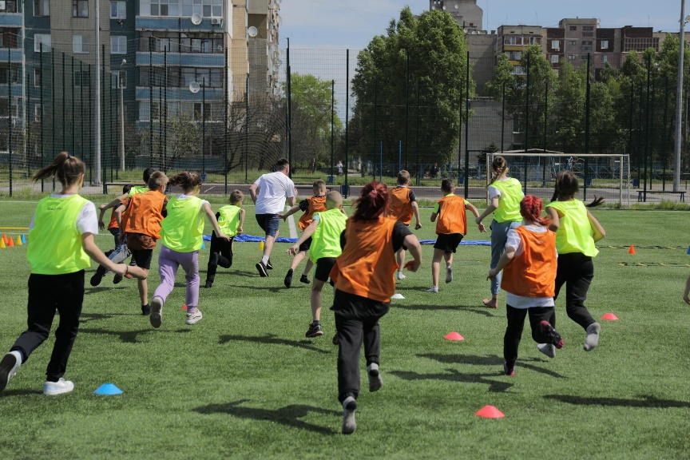
GUESS THE ARTICLE
@UNICEF/Párraga
@UNICEF/Pouget
@UNICEF/Bondan
These pictures provide a clue to this week’s articles.
How do these pictures help you? Can you guess how they are linked together?
Write down your thoughts or discuss with someone in your class.

Slide 4
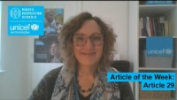

ARTICLE 29
Article 29 (goals of education)
Hilary Alcock, RRSA Professional Adviser, introduces Article 29
Education must develop every child’s personality, talents and abilities to the full. It must encourage the child’s respect for human rights, as well as respect for their parents, their own and other cultures, and the environment.
Click here to watch on YouTube

Slide 5
EXPLORING ARTICLE 29
How can education support you to develop your personality, talents and abilities?
Have a think and write down some answers.

Slide 6
EXPLORING ARTICLE 29
Did you think of these?
Support health and wellbeing
Understanding human rights
Provide a safe space
Treating you as an individual
Learning about different careers
Providing access to music, art and sports
Giving you a voice
Encourage friendships
Trips
Residentials
Outdoor learning
Clubs
What else did you think of?

Slide 7

PRIMARY ACTIVITIES
You do not need to complete every activity but if you have time, you can try to complete more than one.
Which of the hobbies or activities in this video do you enjoy? What other hobbies can you think of? Make a list of all the hobbies that people in your class do.
Watch and listen to this story. What new activity would you like to try? How might you get started? Share your ideas with a partner or your class.
Everybody is different, but education is for everyone and no one should be discriminated against (Article 2). Play this game with CBeebies cartoon star Pablo, to see the different ways his friends like to learn and play. How do the adults in your school make sure that everyone can enjoy their education and develop their talents and abilities?
Work with a partner or small group. Talk about the things that you think each person is really good at or has a special talent for. Consider making a ‘Talent Tree’ for your class with each person’s picture on a leaf with their talents on the other side.

Slide 8
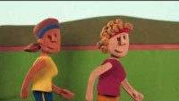

PRIMARY ACTIVITIES 2
You do not need to complete every activity but if you have time, you can try to complete more than one.
Article 29 talks about developing talents, but what is talent? Take a look at this Sport Scotland video discussing the role of talent in sport and work with a partner to decide on your top tips for how to develop a talent.
Article 29 says that education should develop your personality, abilities and talents. Look up these words and discuss their meaning as a class. Create a drawing or write a poem or story to show some of your abilities and talents or an aspect of your personality.
Read The Dot by Peter H Reynolds. At the start of the story Vashti feels like she isn’t very good at art. Can you think of a time where you have found something difficult but you have kept trying until it becomes easier or is there something you wish you could be better at? Share with a friend and make a plan.
Article 29 includes developing respect for human rights. How does your school community show that this is an important part of your education?

Slide 9
PRIMARY ACTIVITIES 3
You do not need to complete every activity but if you have time, you can try to complete more than one.
Article 29 also says we should learn about how to respect our environment – in this video, children talk about the importance of nature and what they’ve been doing to raise awareness. Upload your own tree picture to the digital forest. What could you do to be more nature positive at your school?
Article 29 says that children should be encouraged to respect their own and other cultures. How do you celebrate different cultures at your school? Create a display showing how this happens at your school and talk about why this is important.
Consider ways that you and others can raise awareness of and get involved with the climate action pledges found here.
Carry out a survey in your class to find out what the most popular hobbies and interests are. How can your school help people to enjoy their favourite things to do? How can your school celebrate everyone’s talents? Share your ideas with your school council.

Slide 10

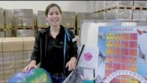
SECONDARY ACTIVITIES
You do not need to complete every activity but if you have time, you can try to complete more than one.
Article 29 describes what education should focus on and stresses its importance. Watch this video that highlights what education means to children around the world. How is this similar to what education means to you? Discuss the barriers that children across the world face when accessing education and raise awareness of this issue in your local community.
Read the wording of Article 29 again. Think about how well your school encourages young people to respect: themselves, others, human rights, their parents and the environment. Rate each category out of 5 with 0 as no encouragement and 5 for lots of encouragement. Share your results with a friend from your school or your school council. What could your school do to improve its rating?
School is not the only place that we learn. Think about the other places and situations in which you learn new skills or develop your talents. Consider undertaking a survey in your class/school to find out what the most popular hobbies and interests are. How can your school help people to enjoy their favourite things to do?
UNICEF has always supported the right to education around the world. Read and watch the video about a School in a Box Share what you have learnt with your class or year group. If you can, find out more about UNICEF’s work to support education around the world.

Slide 11
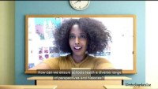
SECONDARY ACTIVITIES 2
You do not need to complete every activity but if you have time, you can try to complete more than one.
To get the best possible education it helps to be a great learner! Work with a friend or small group to create a ‘Learner Top Ten’ – a list of tips for all young people to be the best learners they can be. Talk with your school council about how you could you turn this into an assembly linked to the CRC.
Watch this short film which asks many questions to get us thinking about what kind of education we all need. Choose two or three of the questions asked and discuss them with your class or write your own answers to them.
Work with a partner or small group. Talk about the things that you think each person is really good at or has a special talent for. Consider making a ‘Talent Tree’ for your class with each person’s picture on a leaf with their talents on the other side.
Article 29 includes developing respect for human rights. How does your school community show that this is an important part of your education?

Slide 12

SECONDARY ACTIVITIES 3
You do not need to complete every activity but if you have time, you can try to complete more than one.
Article 29 also says we should learn about how to respect our environment – in this video, children talk about the importance of nature and what they’ve been doing to raise awareness. Upload your own tree picture to the digital forest. What could you do to be more nature positive at your school?
Education and learning have always been at the heart of human progress. What might the future hold? Watch this inspiring video made by UNICEF, ‘Are we listening to the unstoppable?’ Consider how technology supports your education, other talents and abilities and then work with a friend to write your own poetic vision or manifesto for the future of learning for young people.
Consider ways that you and others can raise awareness of and get involved with the climate action pledges found here.
Consider what qualities you need in order to develop a hobby, talent or skill. How does this link to your emotional
health and wellbeing?

Slide 13
REFLECTION
Article 29 speaks of your talents and abilities… how can you develop these?
Who can help you? What might help you?
How can you help a friend or family member to develop and become the best person they can be?

