Slide 1
ARTICLE OF THE WEEK
Notes:
Caption: Nine children live in a family-type foster care setting in the village of Uhryniv near Ivano-Frankivsk. Six of them are under the age of six. The family left Mariupol and now has to start their lives all over again. Together with the foster parents, the children play, clean and do their homework.

Slide 2
INSTRUCTIONS
Slide 3: Introducing Articles 9, 20, 21 & 25
Slide 4: Exploring Article 9, 20, 21 & 25
Slide 5: Some possible answers
Slide 6, 7 & 8: Primary activities
Slide 9, 10 & 11: Secondary activities
Slide 12: Reflection

Slide 3
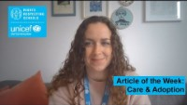
INTRODUCING CARE AND ADOPTION
Care and Adoption
There are many different reasons why children might not be looked after by their parents.
And in these circumstances several articles of the Convention can help guide everyone to ensure that the child or young person’s best interests remain central to the decisions taken.
In this pack we link four articles which closely relate to a child's situation when a decision is made that results in them being cared for by people other than their parents. However, there are many other articles that could apply.
We understand that this topic can be difficult for young people with experience of adoption and the care system, so please do take into account the situation of your learners before you proceed with activities from this pack.
Helen Trivers, RRSA Senior Professional Adviser, introduces Care and Adoption
Click here to watch on YouTube

Slide 4


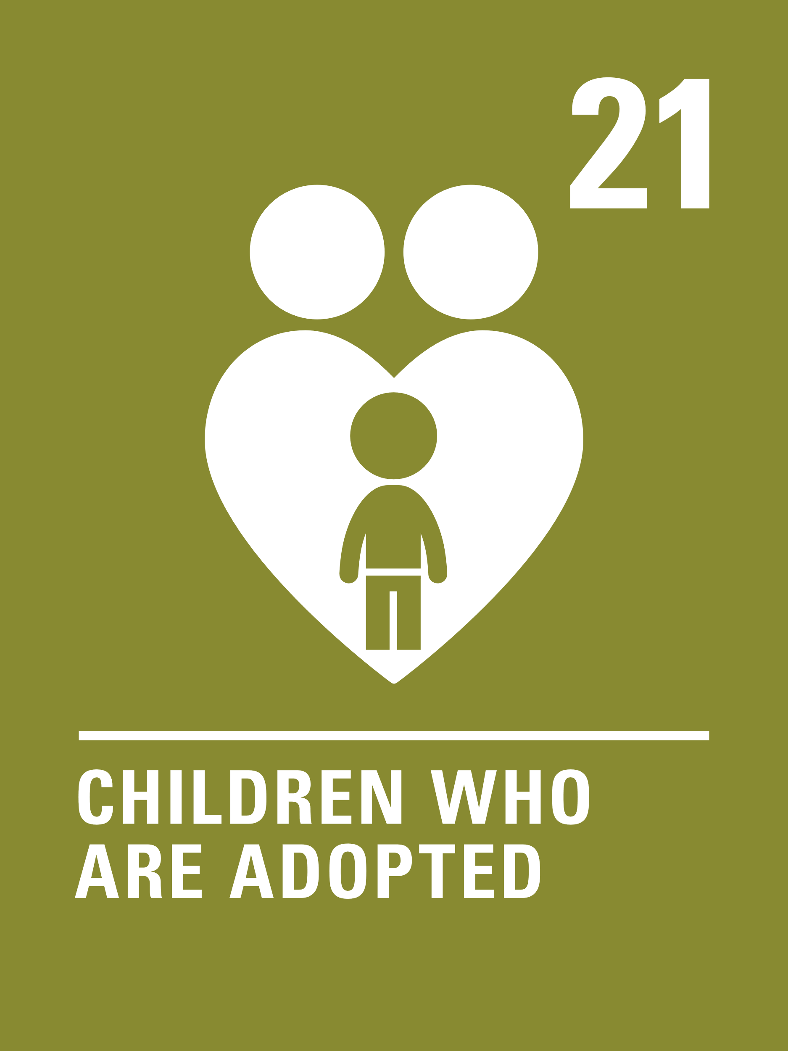

LINKED ARTICLES
Article 9 (separation from parents) Children must not be separated from their parents against their will unless it is in their best interests (for example, if a parent is hurting or neglecting a child). Children whose parents have separated have the right to stay in contact with both parents, unless this could cause them harm.
Article 20 (children unable to live with their family) If a child cannot be looked after by their immediate family, the government must give them special protection and assistance. This includes making sure the child is provided with alternative care that is continuous and respects the child’s culture, language and religion.
Article 21 (adoption) Governments must oversee the process of adoption to make sure it is safe, lawful and that it prioritises children’s best interests. Children should only be adopted outside of their country if they cannot be placed with a family in their own country.
Article 25 (review of treatment in care) If a child has been placed away from home for the purpose of care or protection (for example, with a foster family or in hospital), they have the right to a regular review of their treatment, the way they are cared for and their wider circumstances.

Slide 5
EXPLORING ARTICLES 9, 20, 21 & 25
Why might it not sometimes be possible for children to live with their parents?
Have a think and write down some answers.
Notes:
Caption: A father swings his child in a park close to their temporary shelter Atatürk Boulevard in Adıyaman, Türkiye.

Slide 6
EXPLORING ARTICLES 9, 20, 21 & 25
Did you think of these?
Parents may be unwell and unable to care for them.
Parents may not be able to keep their children safe.
Parents may not be able to provide everything a child needs to be the best they can be.
Family situations may change, for example there may be a crisis.
Parents may live separately, even in different countries.
The child may need long term treatment or care.
Parents may be in prison.
Disasters or emergencies may cause a child to be separated from their family.
What else did you think of?

Slide 7


PRIMARY ACTIVITIES
You do not need to complete every activity but if you have time, you can try to complete more than one.
Not all children live in the same kinds of families, there are families of many different types. Read the book Every Family Is Different by Maureen Eppen or watch this clip and discuss the different types of families you come across. What do you think they all have in common?
‘All About Me’ Draw a picture of yourself with the people who look after you. You might like to add details about who they are. Share your drawing and talk about it with a classmate.
Read The Blanket Bears by Samuel Langley-Swain about little bears who are being cared for by foster carers. What did their foster carers do to make the little bears feel safe and welcome? How were the bears involved in choosing their forever family? You can also watch this video.
All children have the right to be cared for and kept safe. Some children can’t stay at home and need to be cared for elsewhere - with another family member, or in foster care. Foster carers are trained in offering support and care to children in need. Have you ever heard of foster care?
Talk about it in your class, and then watch this video and listen to James’ story. How did this story make you feel? Discuss in class. How would you support James if he moved to your school?

Slide 8

PRIMARY ACTIVITIES 2
You do not need to complete every activity but if you have time, you can try to complete more than one.
Have you ever been away from your parents, carers or family, perhaps on a school trip or a sleepover with a friend? What did you miss the most? How did you keep in touch? Write some top tips for keeping in touch if people can’t be together.
Sometimes children are separated from their parents because of conflict and require additional support. Learn about the amazing work of UNICEF Blue Dot centres. Draw a picture or write about their work so other people can find out about the centres. Can you explain how the Blue Dot centres link to rights?
The Tracy Beaker Podcast is an audio adaptation of the popular books by Jacqueline Wilson. Why not listen as a class and discuss why the books are so popular. Does your library have any other books about children who don’t live with their parents?
Article 20 says that when a child is cared for away from their parents, their CULTURE, LANGUAGE AND RELIGION must still be respected. Discuss why this is important and look at what other rights connect to this.

Slide 9
PRIMARY ACTIVITIES 3
You do not need to complete every activity but if you have time, you can try to complete more than one.
Imagine you had to interview some adults for the role of foster carers or adoptive parents. What sort of questions would you want to ask them and what answers would you hope to hear? Discuss this in groups then compare your ideas with others.
Find out more about the care system, including fostering and adoption, by reading this BBC Newsround article. Find out more about someone who has been fostered or adopted and write a fact file about them.
Article 21 says that adoption must be safe and that children’s best interests must be a priority. It also says that children should only be adopted outside of their country if they cannot be placed with a family in their own country. Why do you think it is important to try and keep children in their own country if possible? What other rights might this link to?
Imagine you are soon to see a parent who you have been separated from for a long time. Write a diary entry to express how you might be feeling.

Slide 10
SECONDARY ACTIVITIES
You do not need to complete every activity but if you have time, you can try to complete more than one.
Read the text of Articles 9, 20, 21 and 25 – select five words or phrases which really stand out to you. Compare your list with others in your group then discuss how these four articles are connected.
The Tracy Beaker Podcast is an audio adaptation of the popular books by Jacqueline Wilson. Why not listen as a class and discuss why you think the books are so popular. Does your library have any other books where children are cared for by people who aren’t their birth parents?
All children have the right to be cared for and kept safe. Some children need alternative care arrangements. Watch this film from Barnardo's and listen to Abi’s diary as she explains how she felt moving into a new foster care home. How did this story make you feel? Talk about it in your class. Create a list of the qualities needed by foster carers.
Article 20 says that when a child is cared for away from their parents, their CULTURE, LANGUAGE AND RELIGION must still be respected. Discuss why this is important and look at what other rights connect to this.

Slide 11

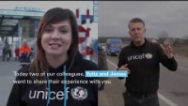
SECONDARY ACTIVITIES 2
You do not need to complete every activity but if you have time, you can try to complete more than one.
Watch this CNN report about young people who have been separated from their parents due to the conflict in Ukraine. Try to link the different parts of the story with their rights.
Learn about the amazing work of UNICEF Blue Dot centres which provide a safe space for families and children on the move in emergencies. One of their roles is to look out for children who arrive alone so that they can protect them. Can you explain how the Blue Dot centres link to rights?
Imagine a new pupil is arriving in your school who has been separated from their parents. They do not know the local area and may be feeling anxious and worried. Put together a ‘Welcome pack’ of information detailing what there is to do in your local area, include practical details such as transport arrangements or information on support, groups or social activities they can join.
Read the Refugee Council’s facts about unaccompanied refugees. Does anything surprise you? What support do you think unaccompanied refugee children will need?

Slide 12
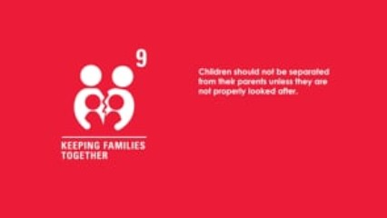
SECONDARY ACTIVITIES 3
You do not need to complete every activity but if you have time, you can try to complete more than one.
Discuss reasons why children might not be able to live with their parents. Watch this video about children who are separated from their parents. Why do you think it is important for young people to speak out about their experiences?
Imagine you are soon to see a parent who you have been separated from for a long time. Write a diary entry to express how you might be feeling.
Find out about the history of The Foundling Museum in London Think about how children who can’t live with their parents have been supported throughout history and how this has changed over time.
Foster carers do a very important job. Read about some foster carers and then write a piece encouraging people to consider becoming a foster carer. Try to mention some rights.

Slide 13
REFLECTION
Take some time and space to have a think….
Who shows you that they care about you?
What feelings do you have when you know you are cared for?
How do you show care to other people in your life?
Why does care matter?
Can you show your appreciation to those who care for you?
Notes:
Caption: A grandparent enjoying a meal with grandchildren in Armenia, where UNICEF offer a special course on positive parenting to over 700 caregivers from across the country.

Slide 14
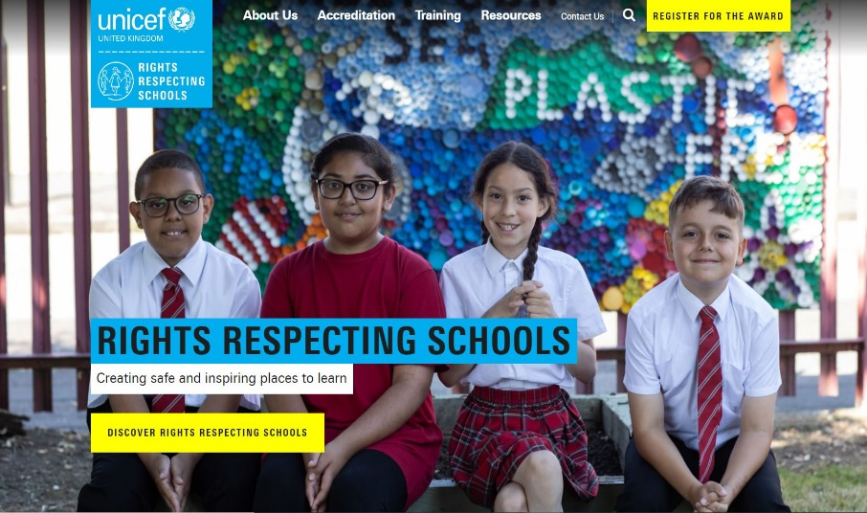
MORE INFO
RRSA WEBSITE
For more information or to download previous Article of the Week packs please visit the RRSA website by clicking on the link below.
CLICK HERE

