Slide 1
ARTICLE OF THE WEEK
UNICEF/Reklajtis

Slide 2
INSTRUCTIONS
Slide 3: Guess the Article
Slide 4: Introducing Article 39
Slide 5 & 6: Exploring Article 39 - Question & Answer
Slide 7 &8: Primary Activities
Slide 9 & 10: Secondary Activities
Slide 11: Reflection

Slide 3
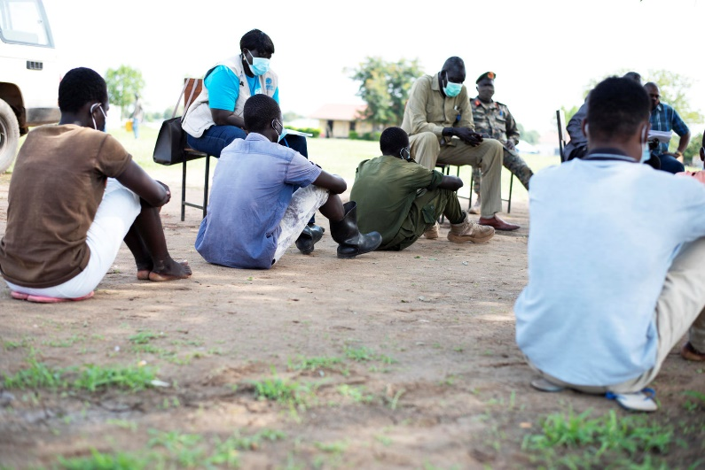
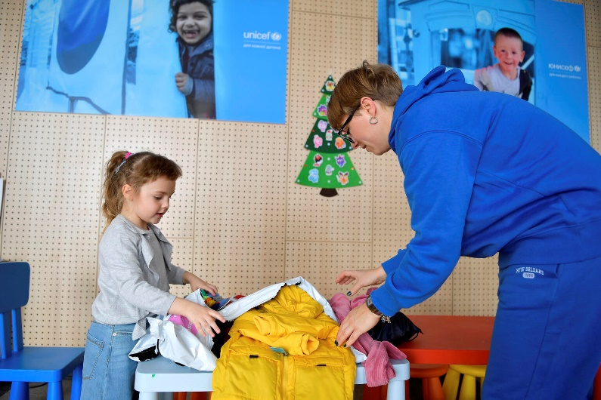
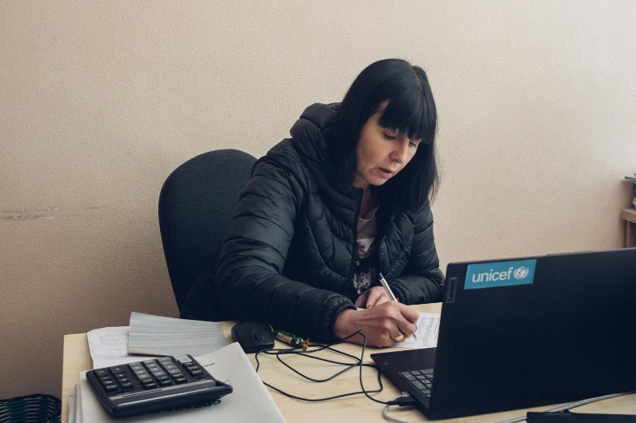
GUESS THE ARTICLE
Children wait to be released from a training facility for Unified Sudan Forces. After their release they were taken to a rehabilitation and family tracing facility.
UNICEF/Ryeng
In the Unicef supported Blue Dot centre, Alexandra and other Ukrainian children received help and support.
UNICEF/Nicodim
Inesa is head of the local Children’s Service in the village of Ivanivka, Ukraine.
UNICEF/Filippov

Slide 4
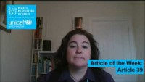

Article 39
ARTICLES 39
Article 39 (recovery from trauma and reintegration)
Children who have experienced neglect, abuse, exploitation, torture or who are victims of war must receive special support to help them recover their health, dignity, self-respect and social life.
Katelyn Farrenson, Professional Adviser, introduces
Article 39
Click here to watch on YouTube

Slide 5
EXPLORING ARTICLE 39
What support do you think a child who has experienced trauma would need to recover?
Have a think and write down some answers.

Slide 6
EXPLORING ARTICLE 39
Space and time to talk to someone they trust
Counselling from a professional
A safe place to live
Time to relax and play
People around them who they love and trust
Support to develop friendships
Medical treatment if needed
Extra support at school
To understand they have the right to be treated with dignity
Did you think of any other examples?

Slide 7
PRIMARY ACTIVITIES
You do not need to complete every activity but if you have time, you can try to complete more than one.
When something bad has happened to someone, it is important that they feel safe. Think about where you feel safe. Draw a picture of your safe place and share it with a friend.
Create a cosy corner in your classroom where people can go to feel safe and secure.
If something bad is happening to someone, who can they tell? Do you know who the Designated Safeguarding Leads are at your school? Draw around your hand and on each finger write a different person that you could talk to if you had a worry or didn’t feel safe.
It’s important to talk about something you are worried about. Some schools have a Worry Box or a Worry Monster.
What does your class have to help you?

Slide 8
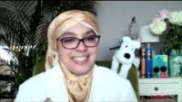
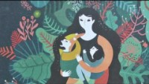
PRIMARY ACTIVITIES 2
You do not need to complete every activity but if you have time, you can try to complete more than one.
Watch this video of Onjali Q Raúf reading from The Boy at the Back of the Class, which is a story about a refugee from Syria joining a new school. Sometimes, people joining a new school have experienced difficult events. What can you do to make someone joining your class feel comfortable and welcomed?
Every child has the right to grow up in a safe, caring home. Draw a baby and around the baby, write or draw things that you think the baby needs to grow up happy and safe. You might think of things like cuddles and lots of rest. What else can you think of?
Watch this video of the book The Journey by Francesca Sanna about a family fleeing war - what difficult things does the family experience? When they finally arrive in a safe place, what will they need in order to ‘begin their story again’?
Because of war, some children and their families have to leave their home as they don’t feel safe to stay there. Some move to another country. Some might start in your school. What could your class do to make the children feel safe and welcome? Write a list of what you would do, or your favourite toy or game you could tell them about.

Slide 9
SECONDARY ACTIVITIES
You do not need to complete every activity but if you have time, you can try to complete more than one.
Every child has the right to grow up in a safe, caring home. Draw a baby and around the baby, write or draw things that you think the baby needs to grow up happy and safe. You might think of things like nurture and a warm place to sleep. What else can you think of?
Children and young people who experience trauma in their life have the right to receive special support. Can you think of some of the different types of trauma a young person could experience during childhood? Working together, discuss this. Write down your concerns and have a think about what support should be put in place.
Traumatic childhood experiences can impact on the development of a child. What does your school do to help you with feelings of stress and anxiety? Create a poster to make sure that all young people in your school know how to access support if they need it.
Read Vishi’s poem about war. Children who are victims of war must receive special support to help them recover. A growing number of children and young people joining schools in the UK are refugees fleeing countries at war. How can schools support such pupils and help them to feel welcome? What role can you and your fellow students play in this? Write your own poem responding to what is happening in conflicts around the world and make sure you refer to UNCRC Articles where you can.

Slide 10
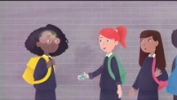
SECONDARY ACTIVITIES 2
You do not need to complete every activity but if you have time, you can try to complete more than one.
Draw a brick wall on a piece of paper, or even build a mini brick wall using blocks or cut up bits of paper or card. Write or stick things on each individual ‘brick’ that you think every child needs to grow up in a safe secure environment. It may be things like, love, food, shelter, protection and to go to school. Once you have filled your wall with all of the things you think a child needs, start taking some bricks away. Think about what happens if children don’t have proper care, or don’t feel safe in their country. What happens to that wall? How can we make sure every child gets everything they need, and the proper help to make sure we fix the gaps? Talk about it in a small group or in your class.
Children fleeing war are at heightened risk of exploitation. Often children are travelling unaccompanied, unable to speak the language, and arriving in countries they know nothing about. How do you think they would feel? What help do you think they should be entitled to? Carry out some research. Find out more - The Children’s Society gives you some facts and figures.
Have you heard of Adverse Childhood Experiences? You may have heard people refer to them as ACE’s. Traumatic experiences in childhood can impact on brain development. Watch this video and share how it makes you feel and discuss how it relates to children’s rights. *
*Please consider the personal circumstances of your learners prior to running this activity.
Children across the world are being impacted by conflict. Read this information from UNICEF and then consider how you could create a campaign or action linked to CRC articles and SDG 16 (Peace, Justice and Strong Institutions).

Slide 11
REFLECTION
Take a few minuets to be still and consider the following…
Talking about children who have experienced trauma or been a victim of exploitation can be very difficult. Every child has the right to receive help if they have been hurt, neglected or badly treated.
Think about how you would help a friend if they came to you looking for support.
What would you say?
Think about where children can receive support – do you know of some resources locally, in school, around the community you live in, or on the internet? Write them down, develop a help list.

Slide 12

MORE INFO
RRSA WEBSITE
For more information or to download previous Article of the Week packs please visit the RRSA website by clicking on the link below.
CLICK HERE

